Slide 1



SCARLET GIMBALED ROCKET DESIGN AND LAUNCH REPORT
ILAN VILLARD, CATHLEEN BOLGER,
MICHAEL WALLACE, ISAAC WENGIER,
JACKSON D’AMBROSIO, JINHE LI,
SYONA GUPTA, ETHAN KOH,
WILLIAM CASTRO
GT RAMBLIN’ ROCKET CLUB – GNC PROJECT
2025 AIAA REGION II STUDENT CONFERENCE, 3 APRIL - 5 APRIL 2025
COPYRIGHT © BY GNC PROJECT AT RAMBLIN’ ROCKET CLUB
PUBLISHED BY THE AMERICAN INSTITUTE OF AERONAUTICS AND ASTRONAUTICS, INC., WITH PERMISSION.

Slide 2

WHO WE ARE
Actively Controlled Rockets
Motivation
Passive fins cannot compensate for variable atmospheric conditions
TVC can improve flight consistency
2

Slide 3
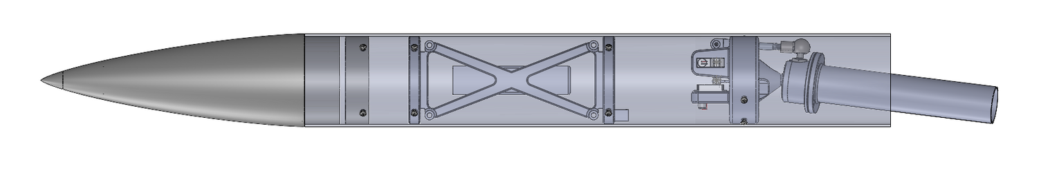
ROCKET OVERVIEW
Basic Design Requirements
Combination of 3D printed parts and COTS components
Max rocket weight: 2 lbs
Designed for quick integration
RECOVERY
3
NOSECONE
AVIONICS BAY
TVC MOUNT

Slide 4

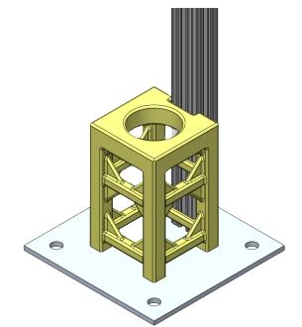
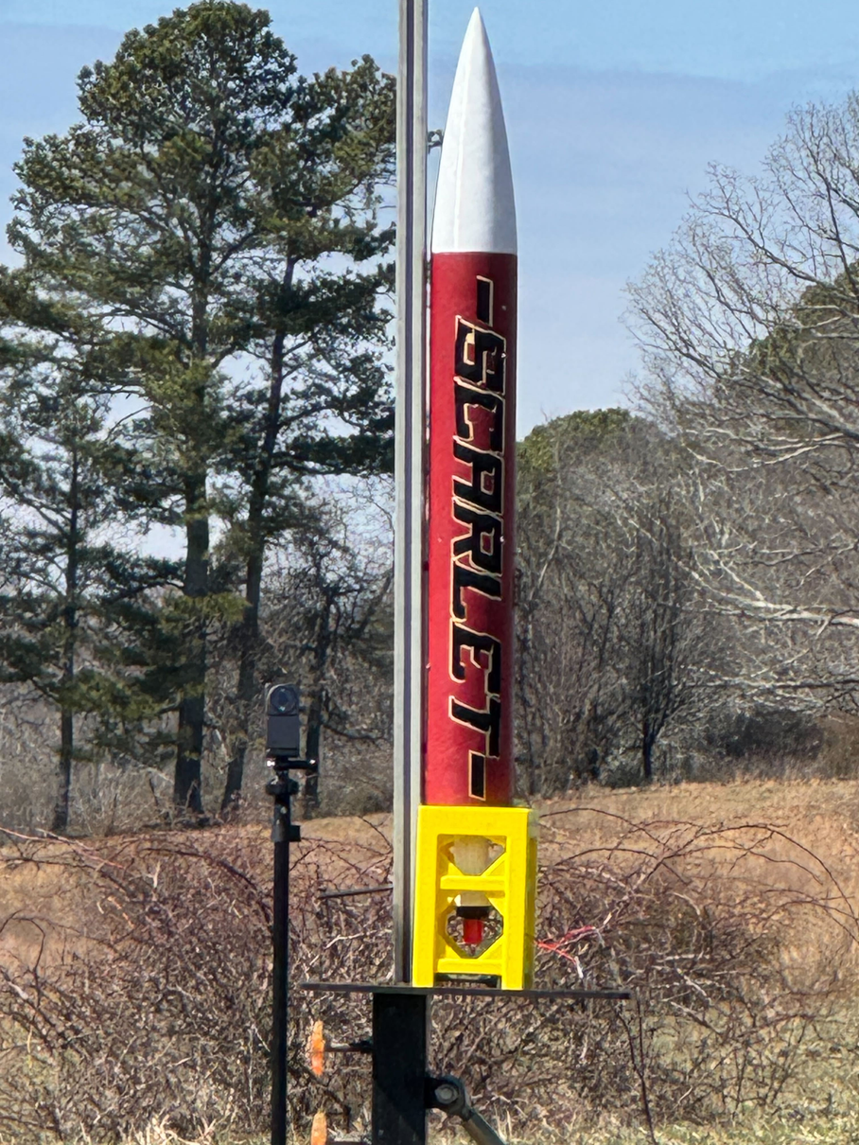
LAUNCHPAD
5-ft T-Slot Rail
Rail length allowed the rocket to gain sufficient initial velocity.
Support provided clearance for TVC and ignition wire.
Base fixated the structure
3D-Printed PETG Support
Aluminum Base
Figure 2: Figure of CAD of Launchpad Assembly
Figure 1: Figure of Photo of Test Stand in Use With Scarlet Rocket at Launch
4

Slide 5
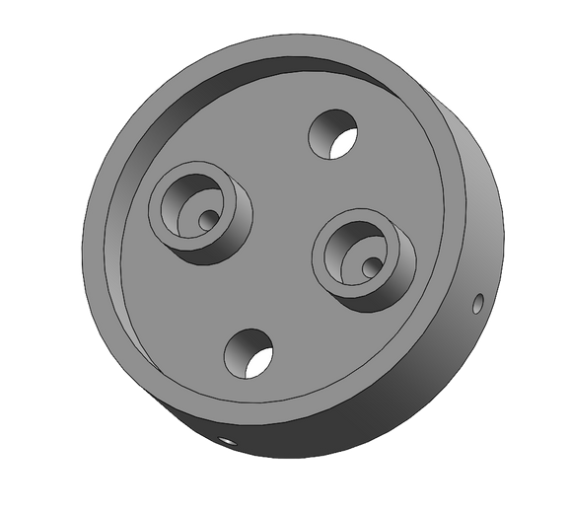
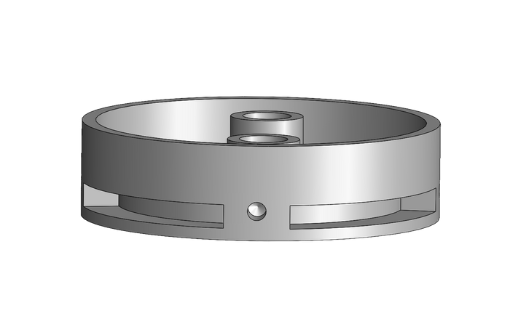
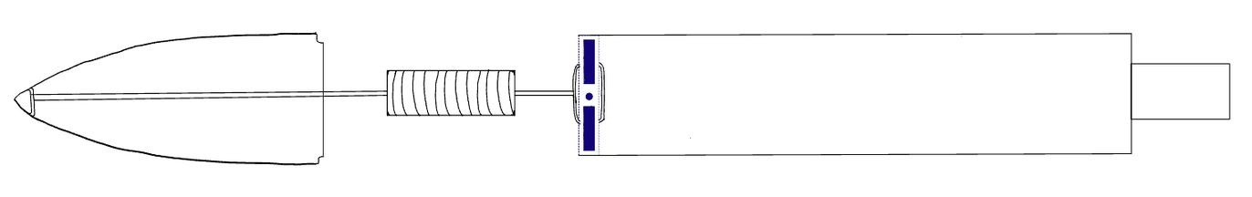
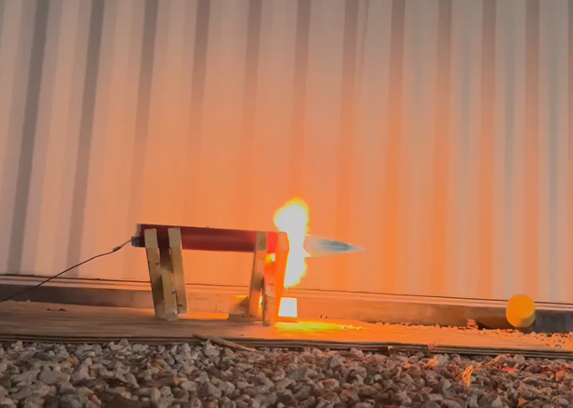
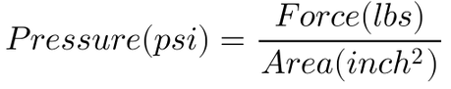
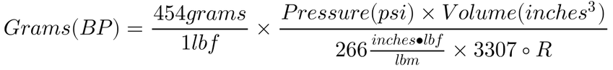
RECOVERY
Single Deployment Recovery System
Pocketing design on radial edges to reduce weight of the bulkhead
Shockcord
18" Nylon Parachute
Recovery Bulkhead
Figure 4: Figure of Isometric Views of Recovery Bulkhead
Figure 3: Figure of Diagram of Recovery System
Figure 5: Figure of Photo of Rocket from Ground Testing
5
Equations 1-3: Pressure, Volume, and Grams Calculation for Black Powder Estimation

Slide 6
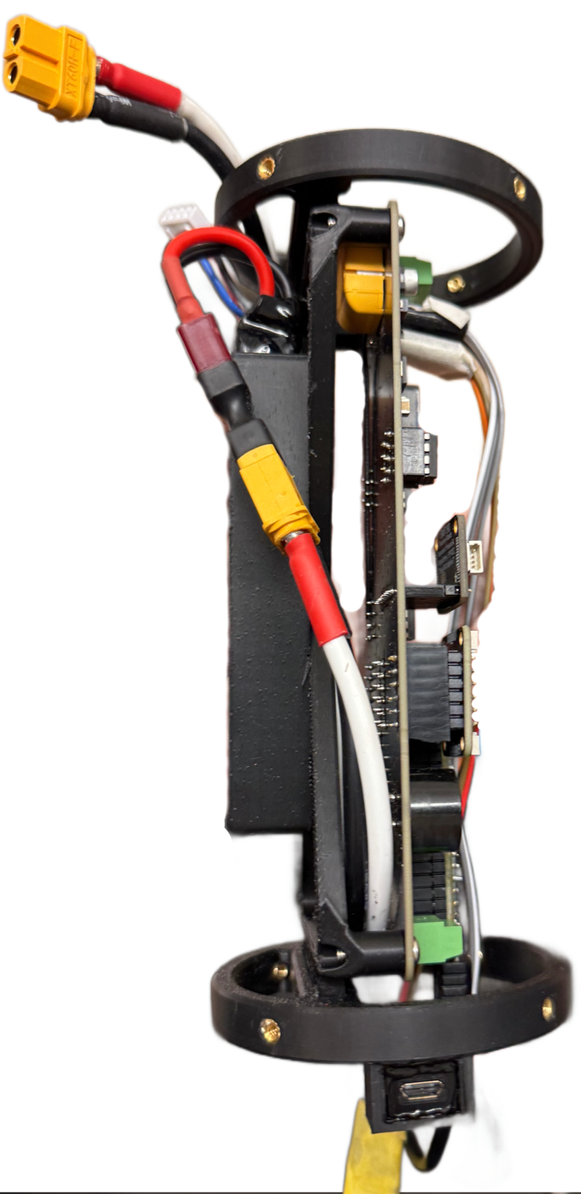
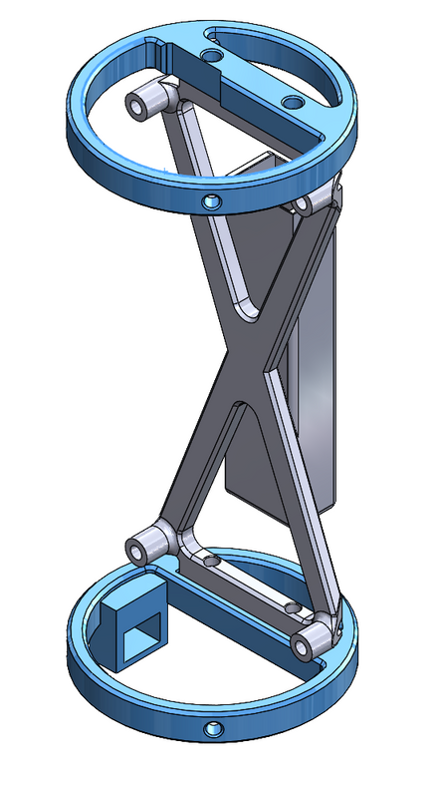
AVIONICS MOUNT
General Requirements
Hold the Flight Computer, Battery, Micro-USB Port
3” body tube, 2.8" wide flight computer
Overview of Components
Two bulkheads
Secured to body tube
Cutouts for pyro channels, servo wires, XT60 power plug
Frame
Flight computer, battery
Figure 6: Isometric View of Avionics Bay
Figure 7: Integrated Avionics Bay
6

Slide 7
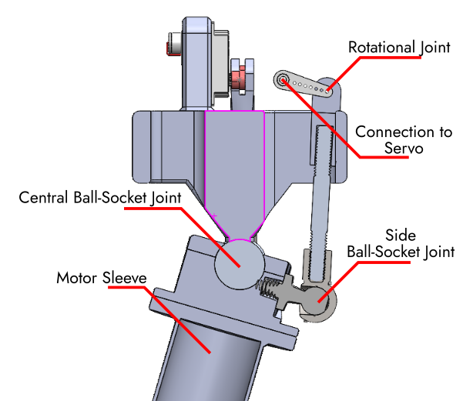
TVC MOUNT
General Requirements
+/- 20 Degrees Range of Motion
360-degree actuation
Integrated with Flight Computer
COTS + 3D Printed Components
Overview of Components
Top plate fixed in body tube
Ball-and-Socket Joint
KST X08 Digital Servos
Positioned in line with the pitch and yaw axes
Rotational joint to linkage bar to side ball-socket joint
Uncoupled pitch and yaw controls
Figure 8: Front Cross-Section of TVC
7
Notes:
The goal of the Thrust Vectoring Mount, or TVC as we call it, was to gimbal the G12 motor plus or minus 20 degrees in any direction to actively stabilize Scarlet and correct deviations from its intended flight path.
To achieve this 20-degree range of motion, the gimbal system commonly used on other TVC rockets was instead replaced with a unique articulation system.
As shown in the figure to the right, this system has a central ball-and-socket joint which allows the motor to pivot around the top plate, which is screwed into the body tube. The KST X08 digital servos pitch and yaw the motor through a rotational joint connected to a linkage bar and a side ball-and-socket joint.
These side ball-and-socket COTS joints allow each axis to rotate and move independently of the other, allowing for uncoupled pitch and yaw controls. There is a linear relationship between deflection of the servos and the motion of the motor.

Slide 8
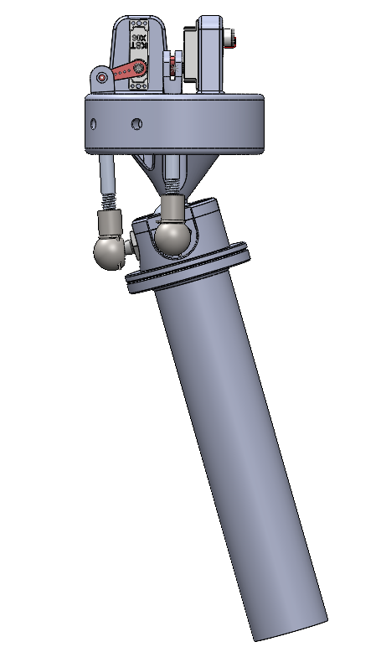
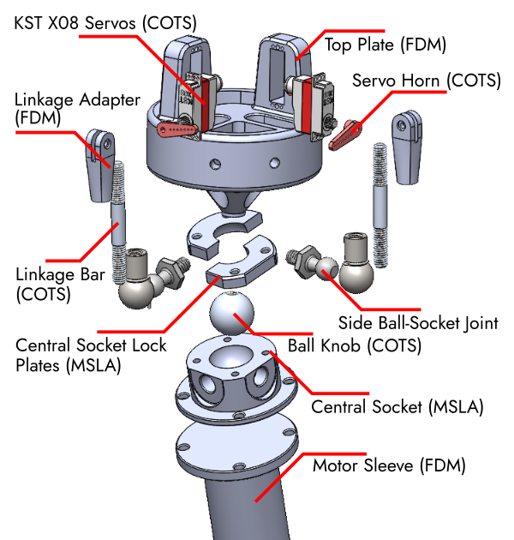
TVC MOUNT
8
Figure 9: Exploded View of TVC
Figure 10: Side view of TVC Mount
Notes:
On your left, you can see an overview of the various components with their manufacturing method. We used a mix of metal COTS parts, such as the ball knob and linkage bars, and FDM and MSLA components to create this novel motion system.
Overall, the TVC mount performed very well and will be further refined with future iterations. Some areas of improvement include reducing the play in the mount when the servos are engaged, refining the assembly procedure, and redesigning it to be more inherently stable.

Slide 9
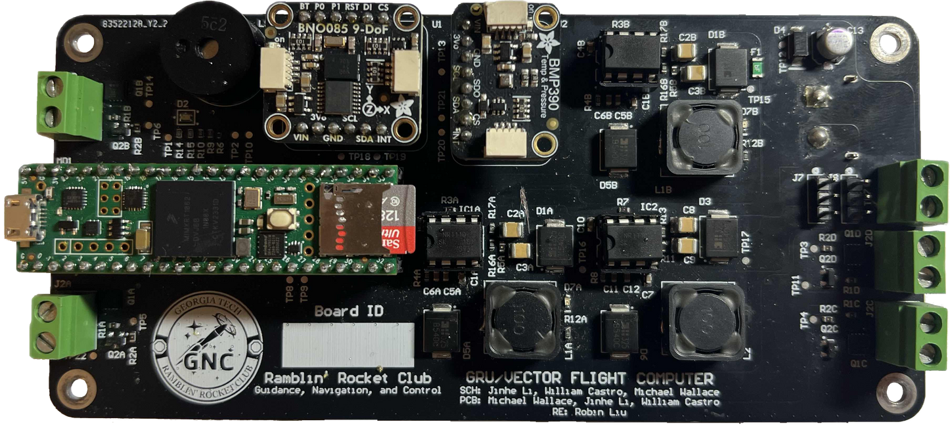
FLIGHT COMPUTER
5 V Buck
General Requirements
Needs to power:
Teensy Microcontroller
4 pyro channels
Buzzer
LEDs
Sensors (Inertial Measurement unit (IMU), Barometer)
XT60 Plug
LED/Buzzer
BNO085 IMU
BMP390 Baro
Servo Outputs
Teensy 4.1
Pyro Buck (5V)
Servo Buck (7.4V)
9
Notes:
- General requirements for flight computer
- Micontroller to run software
- Pyro for recovery, other events if needed
- Buzzer and LED for launcsite and testing feedback
-Sensors for position and attitude determination
- Power was provided using an XT60 plug
- Our micontroller allowed us to run software, along with reading to an SD card to collect in flight data, and additionally power sensors simplifying power management on the board
- The IMU used was the BNO085, which uses built in sensor fusion to directly output quaternions through i2c. This allowed us to focus on other aspects of the software. A 250hz max orientation sampling rate, which would be the most important at low velocities, was sufficiently high
- The barometer used was the bmp380
- Three buck convertors used, one for pyro's, one for the board, and another to power the servos
- The rest of the components were relatively standard

Slide 10
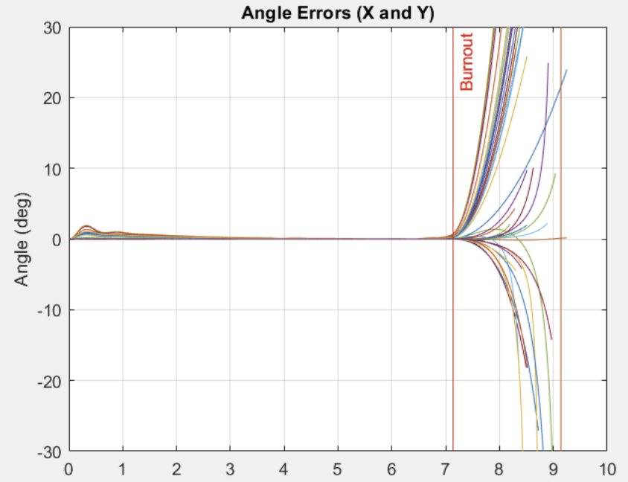
SIMULATIONS
Closed Loop Simulation done in Simulink
Gimbal angles converted to world frame
Thrust inputted to 6DOF joint for dynamics
Attitude errors calculated, passed into PID blocks
PID blocks used to change gimbal angle
First adjusted to G12ST thrust
Figure 12: PID Errors for Monte Carlo Simulations
10
Notes:
- Simulations done in simulink to get an initial tuning of values
- Everything done in a closed loop with various steps
- Firstly, we take the previous gimbal angle and thrust and convert the thrust vector to a world frame
- This is used to update the dynamics of the rocket
- After the rocket's position and angle is updated, the errors from 0 are calculated and passed into PID blocks
- The gimbal angle is scaled, based on current thrust compared to a "base value"

Slide 11
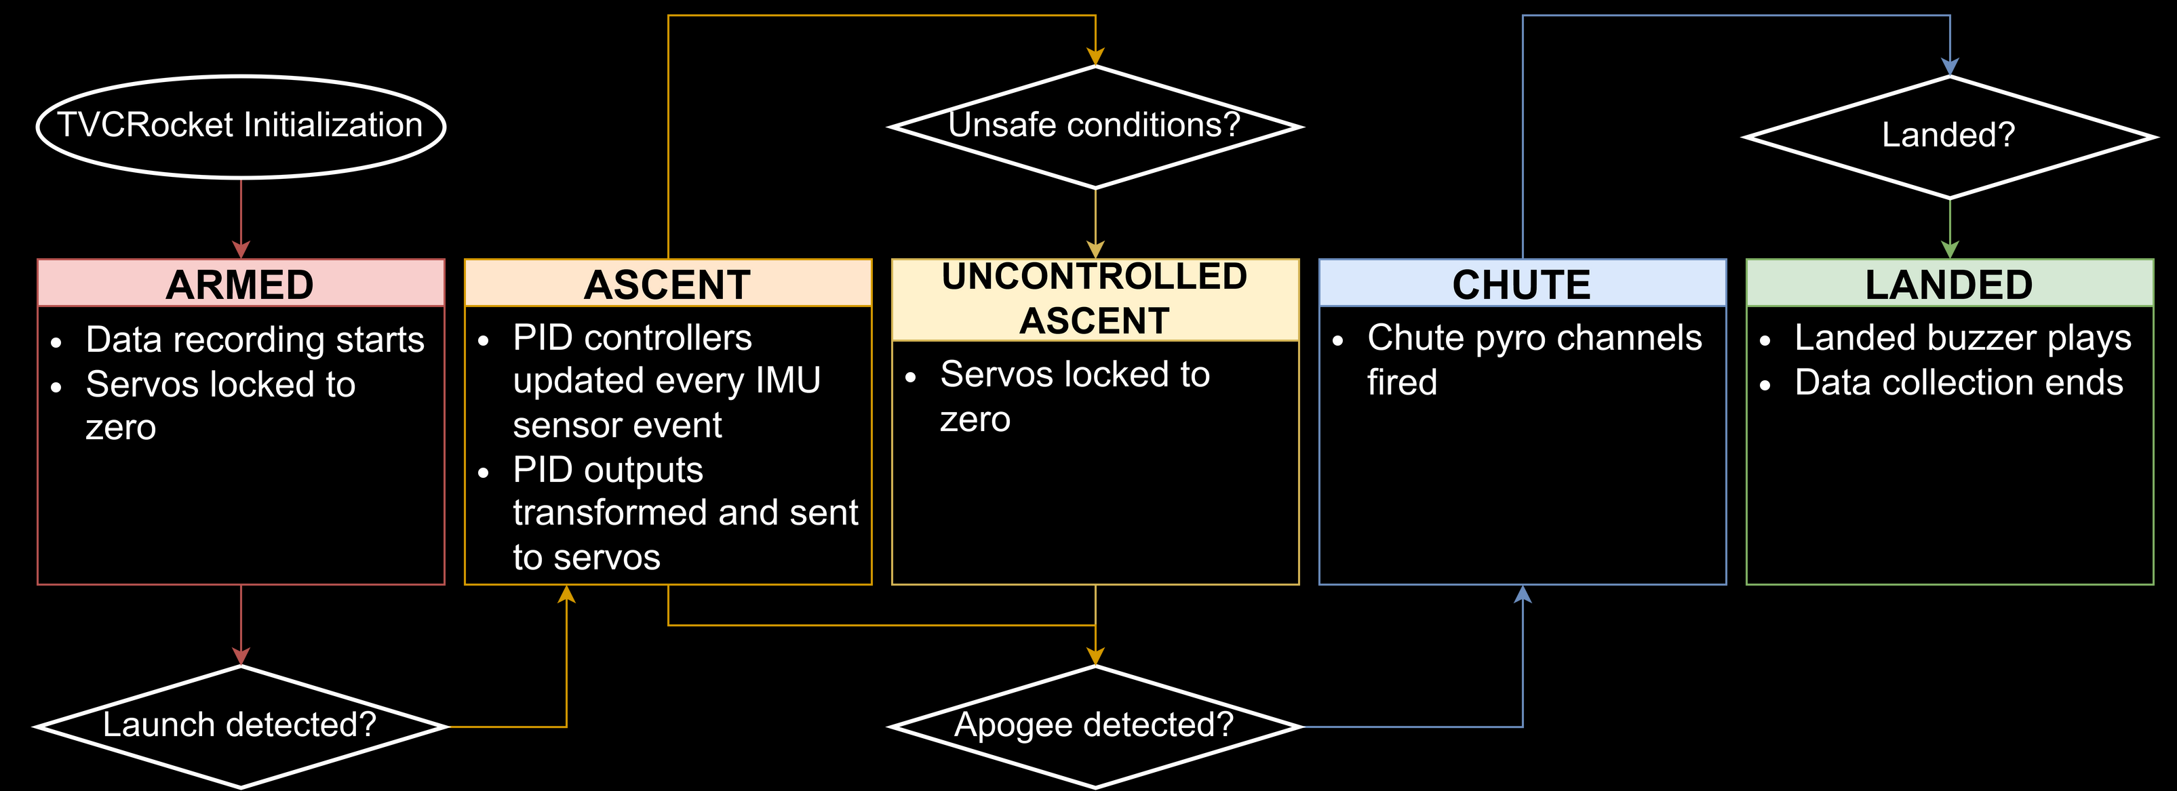
FLIGHT SOFTWARE - STATE MACHINE
11

Slide 12
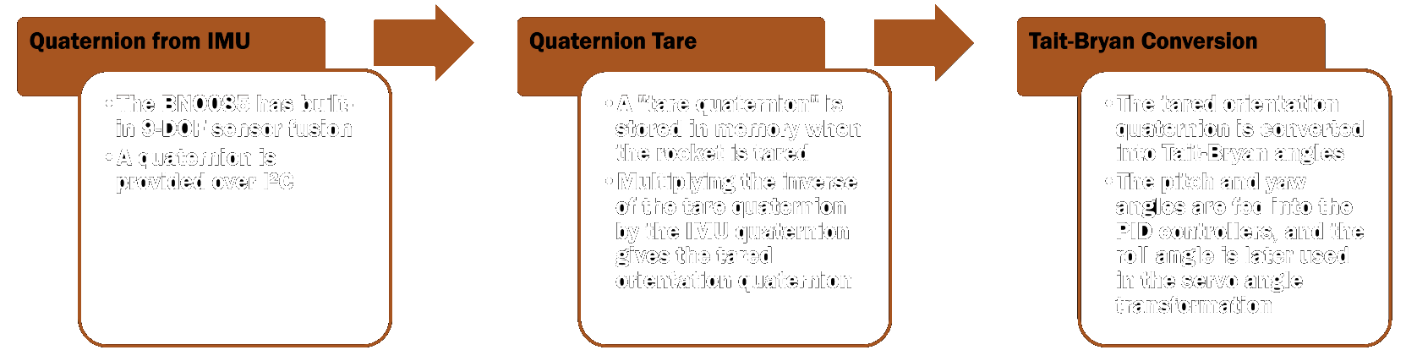
FLIGHT SOFTWARE - ORIENTATION
12

Slide 13
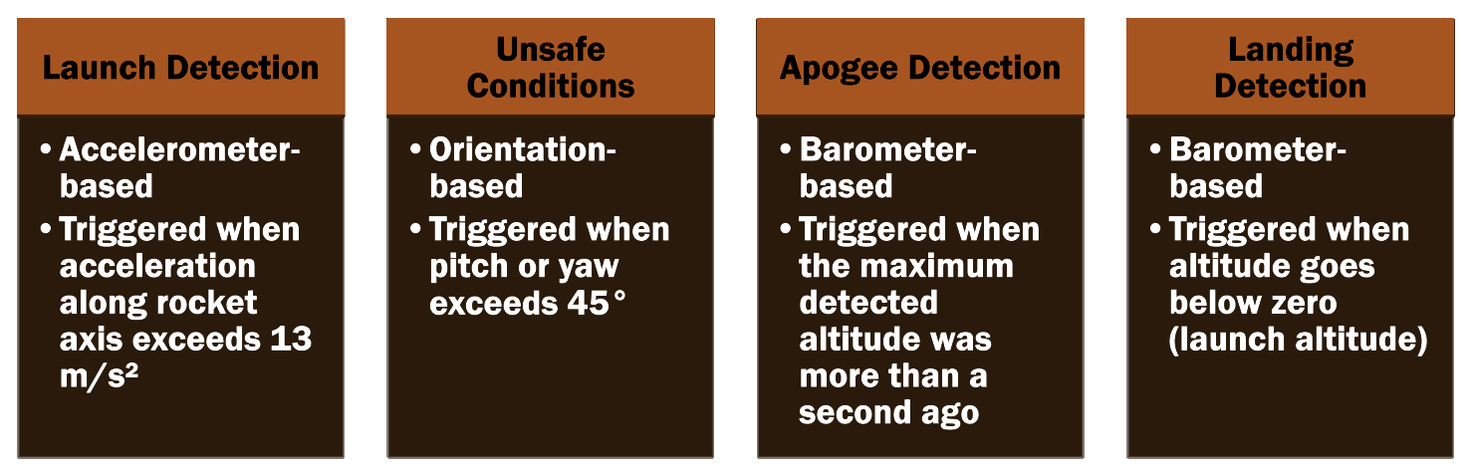
FLIGHT SOFTWARE - EVENT DETECTION
13

Slide 14
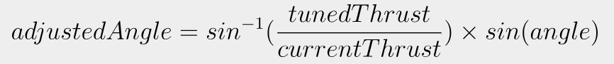
FLIGHT SOFTWARE – ROLL & NONLINEAR ​THRUST ADJUSTMENT
Roll Adjustment
Nonlinear Thrust Adjustment
IMU reports yaw, pitch and roll relative to an inertial reference frame​
PID controllers work in this inertial reference frame, with each servo being a combination of the yaw and pitch PID output​, mirroring the 2D rotation matrix
The PID controllers are tuned at a constant "tuning thrust"​
The angle outputs are transformed based on the current thrust (as read from a thrust curve on the SD card) to produce the same moment at varying thrust forces​
14
Equations 4-5: Roll Adjustment
Equation 6: Thrust Adjustment

Slide 15

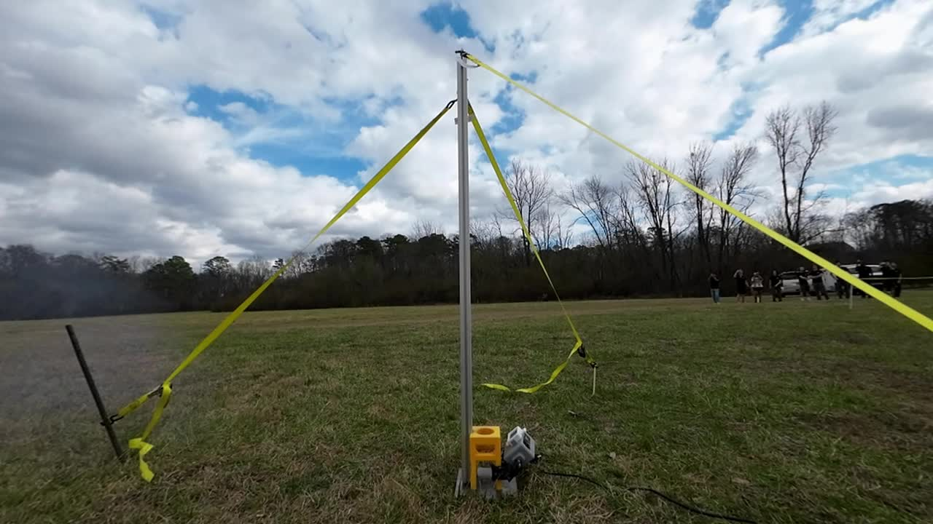
FINAL ROCKET OVERVIEW
Three launches over 2 days (once on launch day one, twice on launch day two)
Integration improvements and weight savings for second and third launch
Launched on a G12ST motor with about 12.7 seconds of burn time
Figure 13: Scarlet off the Launchpad
15

Slide 16
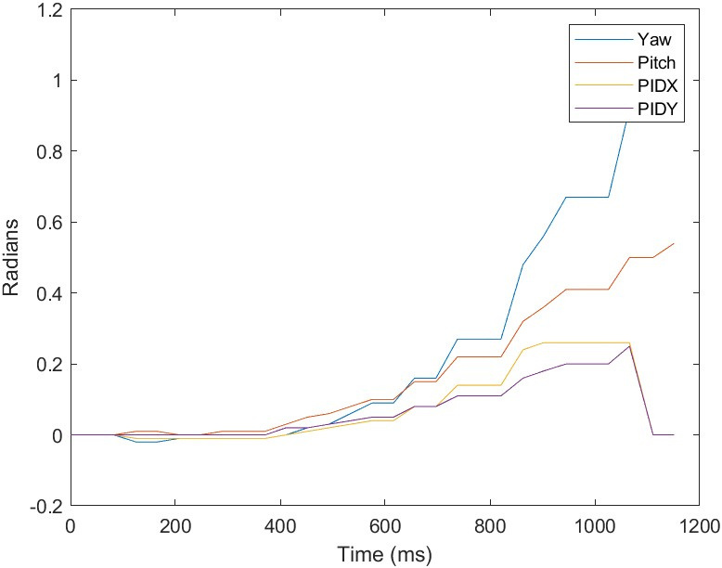
RESULTS
Flight 1 Results
Delayed response due to low P value
Jagged graphs due to low sampling rate
TVC was unable to respond to large gust of wind
Initial response to pitching of rocket in first few seconds
Unsafe conditions reached at about 1 second after launch
Figure 14: Data from Flight 1
16
Notes:
For flight 1, you can see a lackluster response on the gimbal angles due to low P value
We can also see jagged graphs because we were sampling at too low of a rate due to a software glitch. This glitch was only resolved after all the test flights, so this is behavior that mirs and worsens behavior on all flights
A large gust of wind prematurely ended this flight, causing unsfafe conditions after about 1 second after launch, but the rocket was still able to initially respond to some pitching

Slide 17
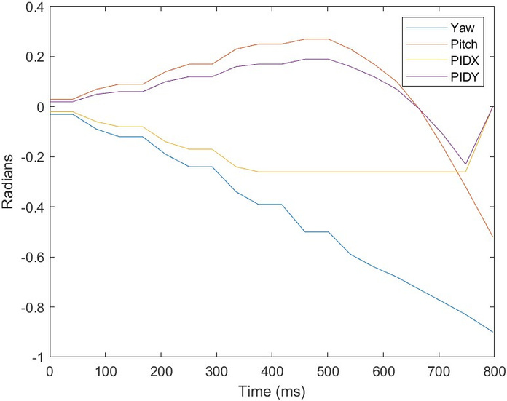
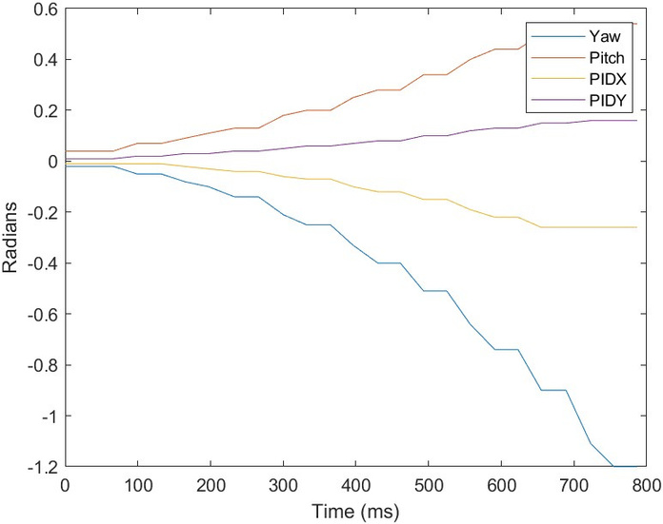
RESULTS 2 AND 3
Flight 2 Results
Overcorrected initially, then delayed response
Due to large P values
Low sampling rate led to delay in responding to overcorrection
Servos reached software limit
Flight 3 Results
Controller failed to respond to rocket pitching
P values much too low
Still a lack of solid sampling rate
17
Figure 15: Data from Flight 2
Figure 16: Data from Flight 3
Notes:
For flight 2, we pumped up the P gain, and could see the rocket overcorrecting
We can see how much more responsive the gimbal angle values are in the graph
That being said, there was a delayed response to overcorrection likely due to the low sampling reate
It's important to note that at one point during flight the servo angles reached a built in software limit
For flight 3, the P value was lowered so much that there was very little response from the rocket.

Slide 18
CONCLUSION
Scarlet was able to respond to pitching of the rocket
A low sampling rate meant that stabilization was very low
Future of the project
More testing of TVC system
Increased sampling rate
Solution implemented and ready for testing
Barometer was rate-limiting loop time
Improved TVC system with higher accuracy
18

Slide 19
ACKNOWLEDGEMENTS
~ Georgia Tech SGA ~
~ Georgia Tech AIAA Chapter ~
~ Ramblin’ Rocket Club ~
~ Daniel Guggenheim School of Aerospace Engineering ~
~ Jorge Blanco (Launch Site Coordinator) ~
19

Slide 20



